Slide 1
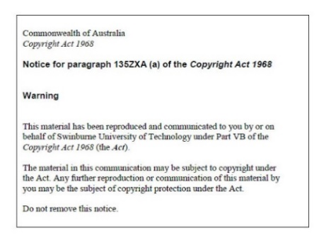
Lecture 11 – Part B
API, JSON, YAML
Armita Zarnegar
Check-In
Notes:
20410D
6: Implementing Dynamic Host Configuration Protocol

Slide 2
Overview
What is API
Different kind of APIs
What is JSON?
JSON structure and data types
JSON Schema
JSON validators
JSON and API
What is YAML and most common Usecases

Slide 3
Application Programming Interface (API)
It is set of protocols, routines, for building software applications
API provides a way for different software applications to communicate with each other easily
Example: Domain website offers APIs to access the aggregated data from their website or ChatGPT offers an API to be able to apply topic modelling on several documents

Slide 4
Different kind of APIs
RESTful APIs: A RESTful API is a type of web API that uses HTTP requests to perform CRUD (Create, Read, Update, Delete) operations on data. RESTful APIs are stateless.
SOAP APIs: A SOAP API is a type of web API that uses the SOAP (Simple Object Access Protocol) protocol to exchange data between applications. SOAP APIs are more complex than RESTful APIs, but they offer more features and functionality.
GraphQL APIs: A GraphQL API is a type of web API that uses the GraphQL query language to retrieve data from a server. GraphQL APIs offer more flexibility than RESTful APIs, as clients can specify exactly what data they need.

Slide 5
JSON
JavaScript Object Notation (JSON): It is a data representation format
Commonly used for APIs, configuration, infratructure as a code in cloud services and data exchange
Lightweight due to small file size and easy to read and write
Easy to integrate into JavaScript and other programming languages

Slide 6
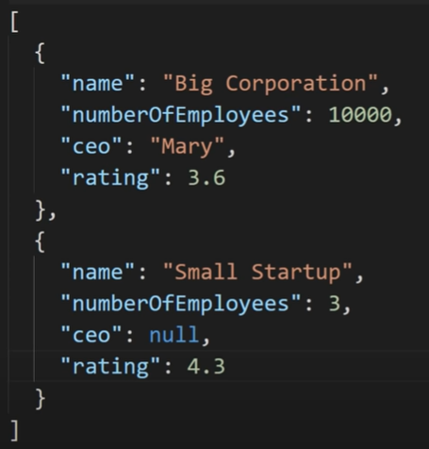
JSON Structure and Data Types
Supports following data types: String, Numbers, Boolean, Null, array and objects
JSON file have .json extension
File format is that we have multiple key: value pairs, separated by comma and each object is surrounded by {}

Slide 7
JSON Validator
You can use VS code extension
An online tool: JSON Online Validator and Formatter - JSON Lint
Notepad++ plugin for JSON

Slide 8
Setting up Twitter for a website
To create a twitter for you websites widget, you can use twitter APIs as it is described in below links which returns a JSON document including twits
Visit the official source

Slide 9

JSON Schema

Slide 10
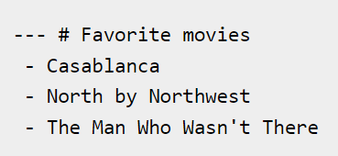
YAML (Yet Another Markup Language)
YAML files store information
It presents data in a way that is easy to read (easier than JSON)
Any data or structure added to an XML or JSON file can also be stored in YAM
YAML is case sensitive
YAML files have .yaml as the extension
Uses hyphen+space to begin a new item in a specified list

Slide 11
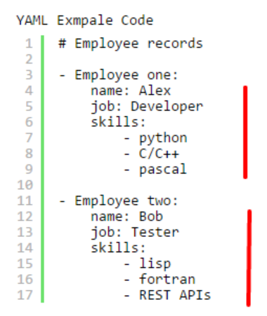
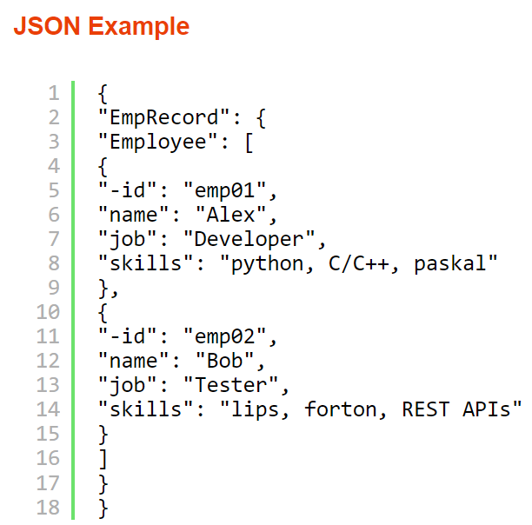
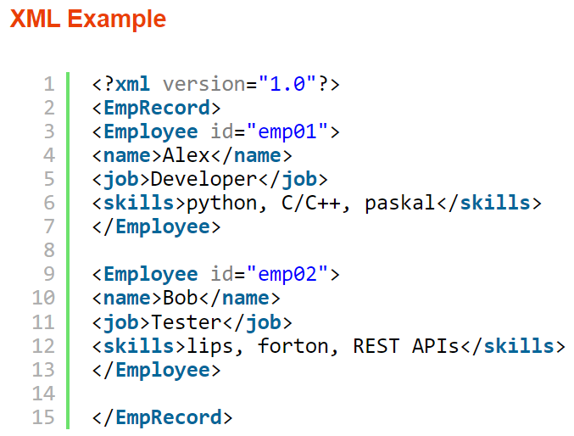
YAML, JSON and XML

Slide 12
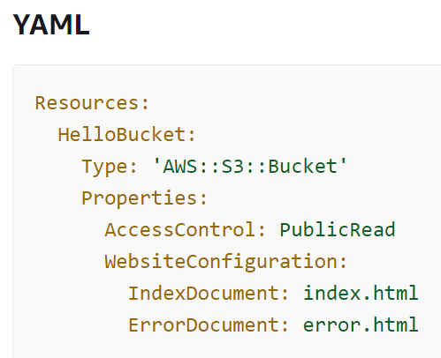
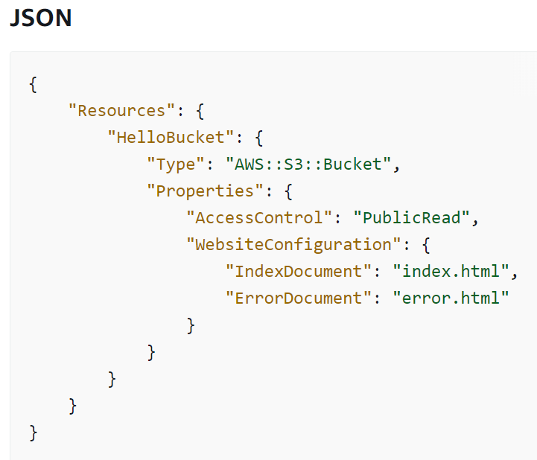
YAML use case- Cloud Architecture

